Slide 1
IUCN SDM Course
Lausanne

Slide 2
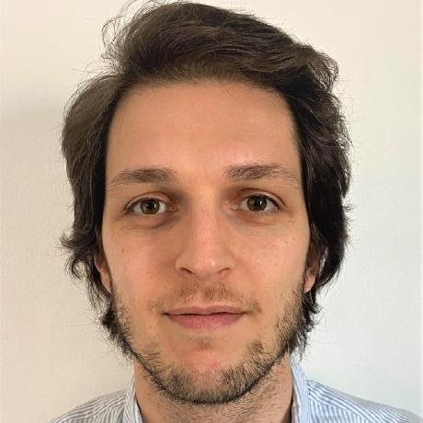


Federico Riva
BSc and MSc at UniTo
PhD at UAlberta
PDF at UAlberta, Carleton U, UNIL
Landscape ecologist and conservation scientist
IUCN Butterfly and Moth SSC and Young Professional group
@riva_ecology Federico.riva.1@unil.ch

Slide 3
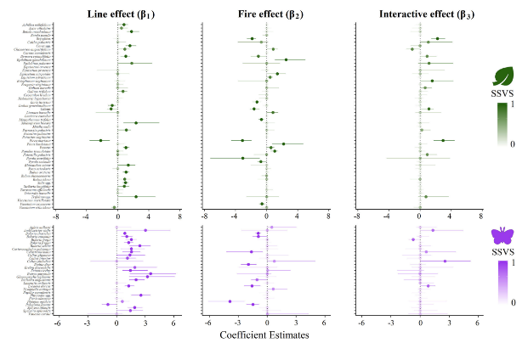
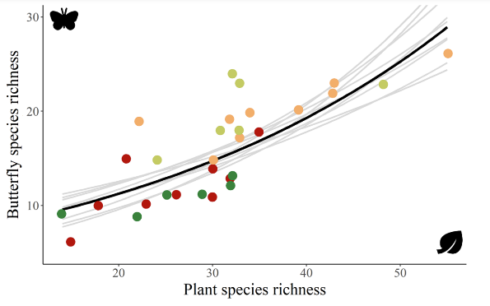
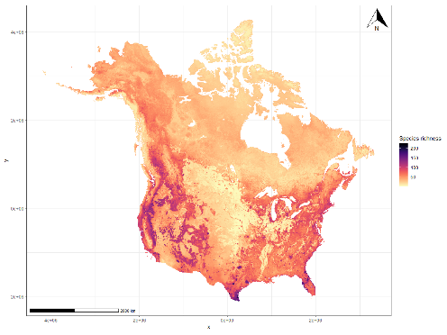
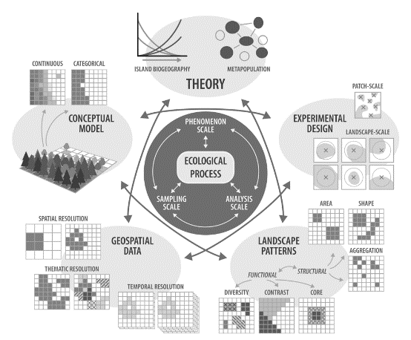
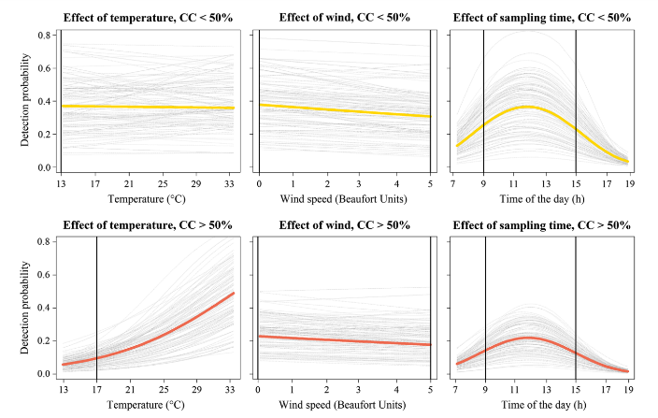
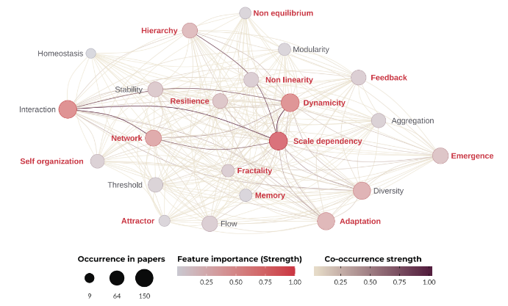
Community ecology Macroecology Biogeography
Landscape ecology Hierarchical models Complexity

Slide 4
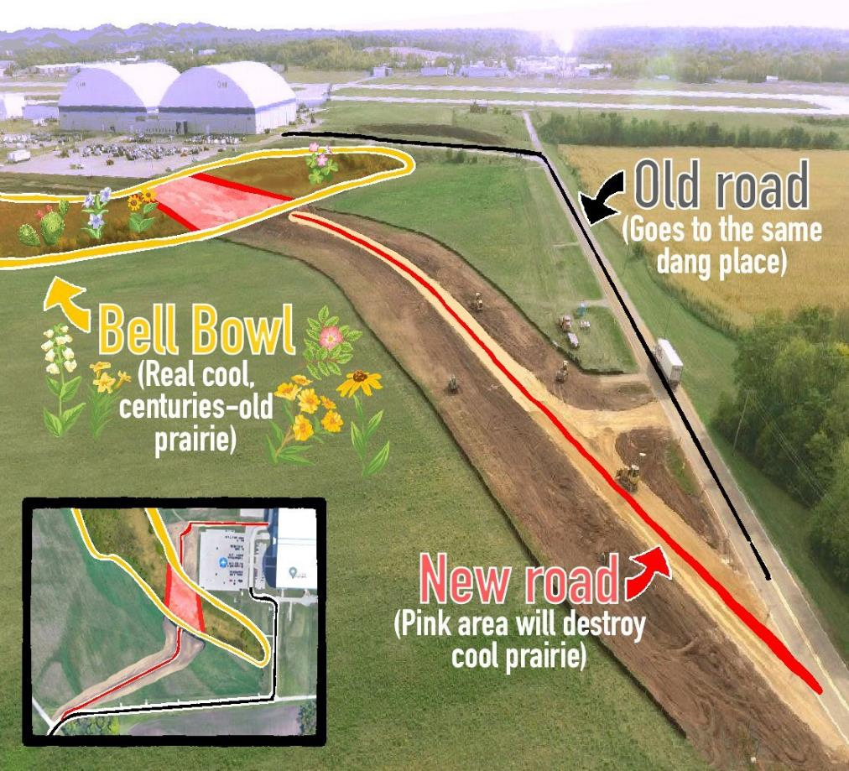
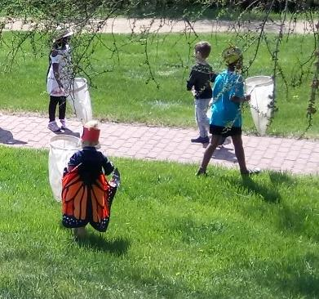
“Bottom up” biodiversity conservation

Slide 5
Key concepts for SDMs

Slide 6
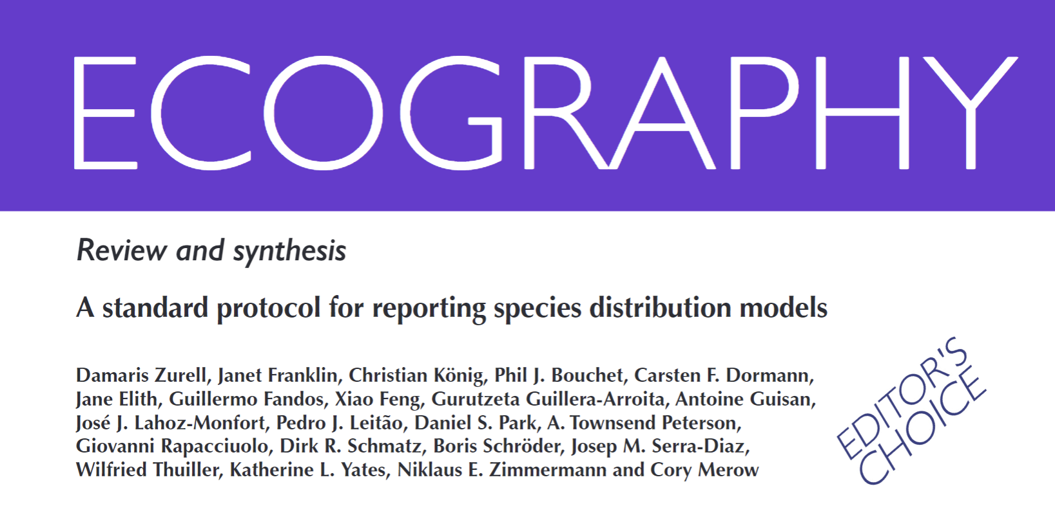

Slide 7
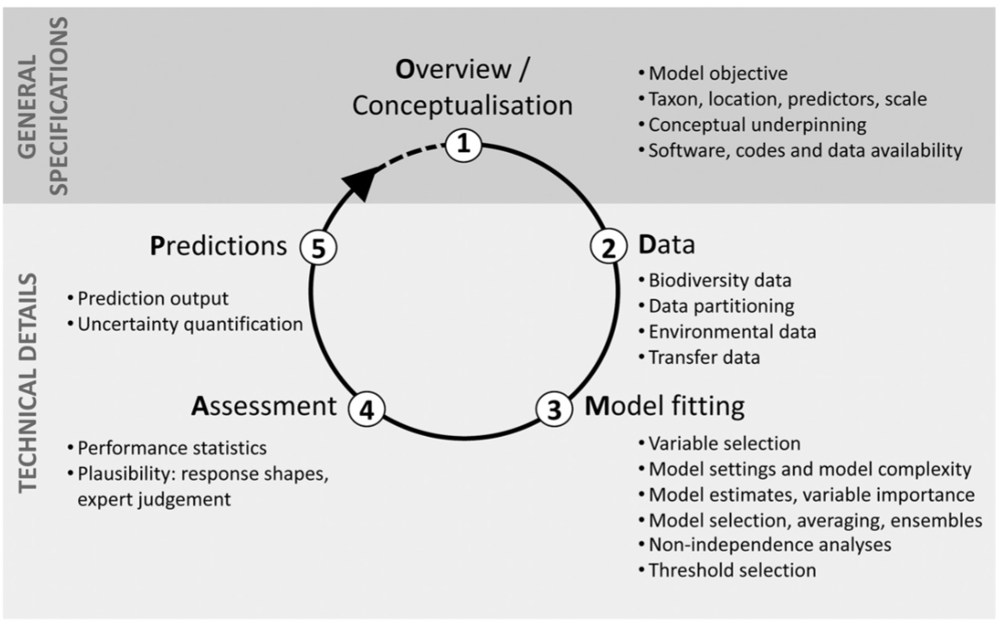

Slide 8
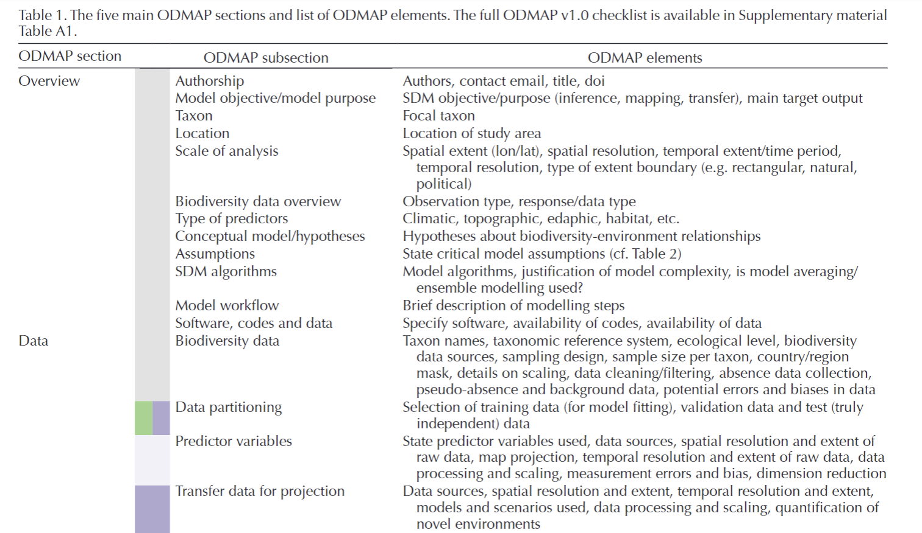

Slide 9
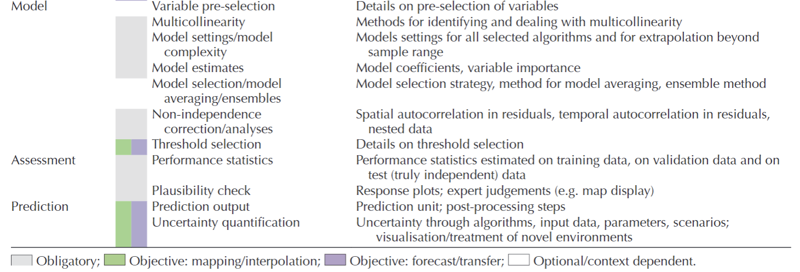

Slide 10
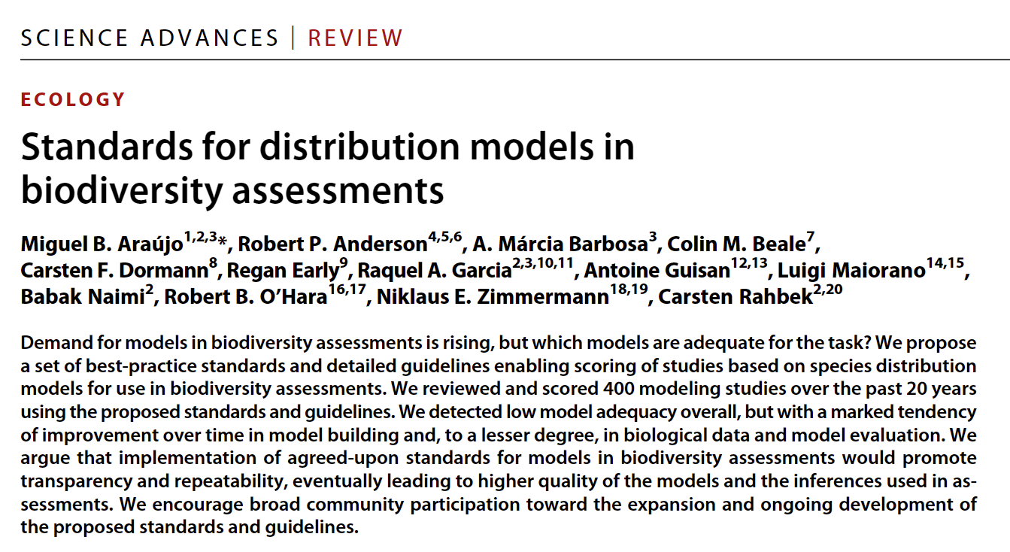

Slide 11
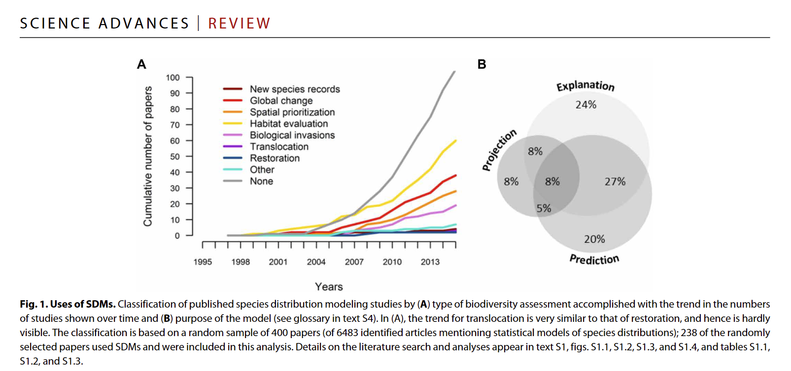

Slide 12
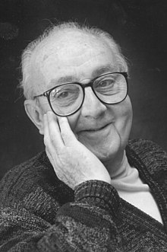
All models are wrong, but some are useful George E.P. Box

Slide 13
Preparing biodiversity data

Slide 14
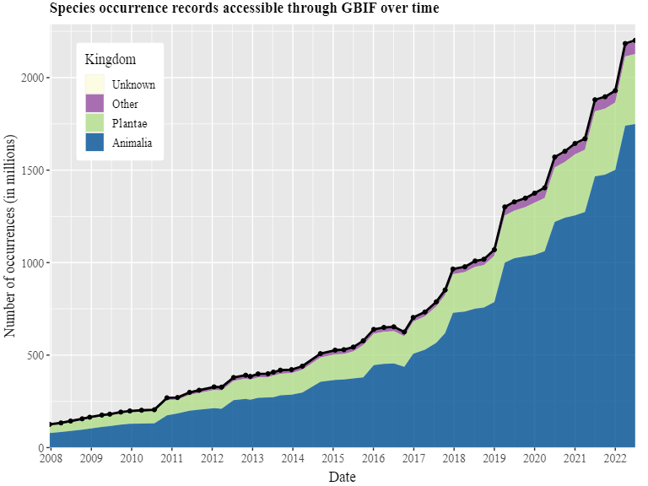
Lots of data

Slide 15
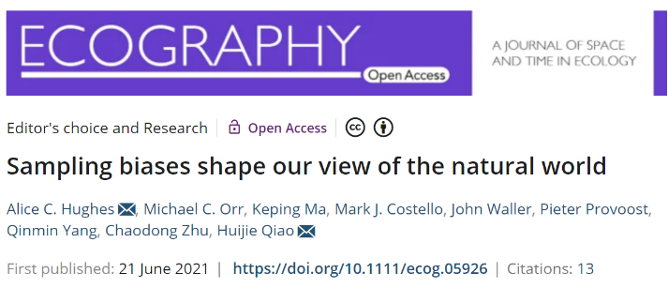
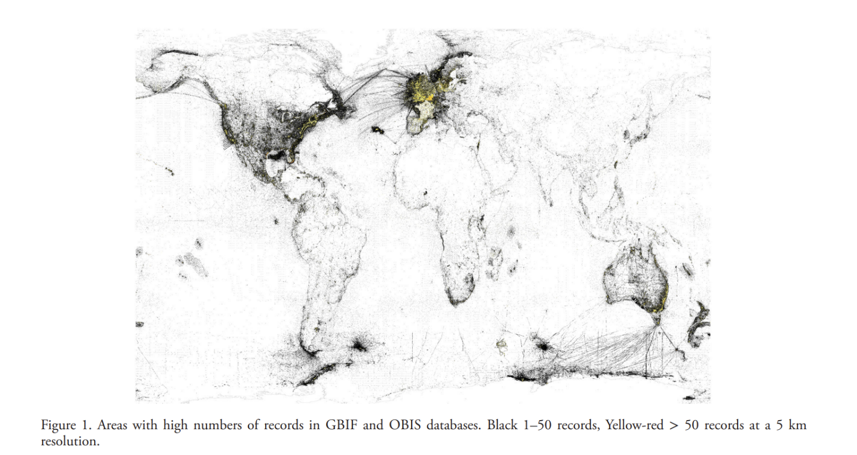
Not enough data

Slide 16
We have a ton of data, but unevenly spaced
SDMs can be used to address this “Wallacean shortfall”
Statistical approaches can account for limitations in data, but typically data quality >> method

Slide 17
Different types of data
Information in the data
Occurrence locations
Presence and absence data
Detection and non-detection data

Slide 18
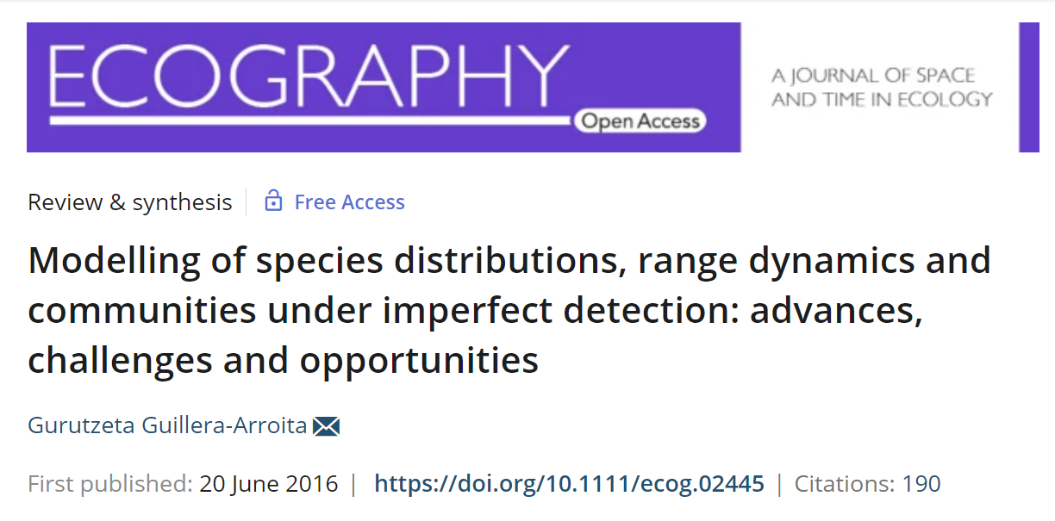

Slide 19
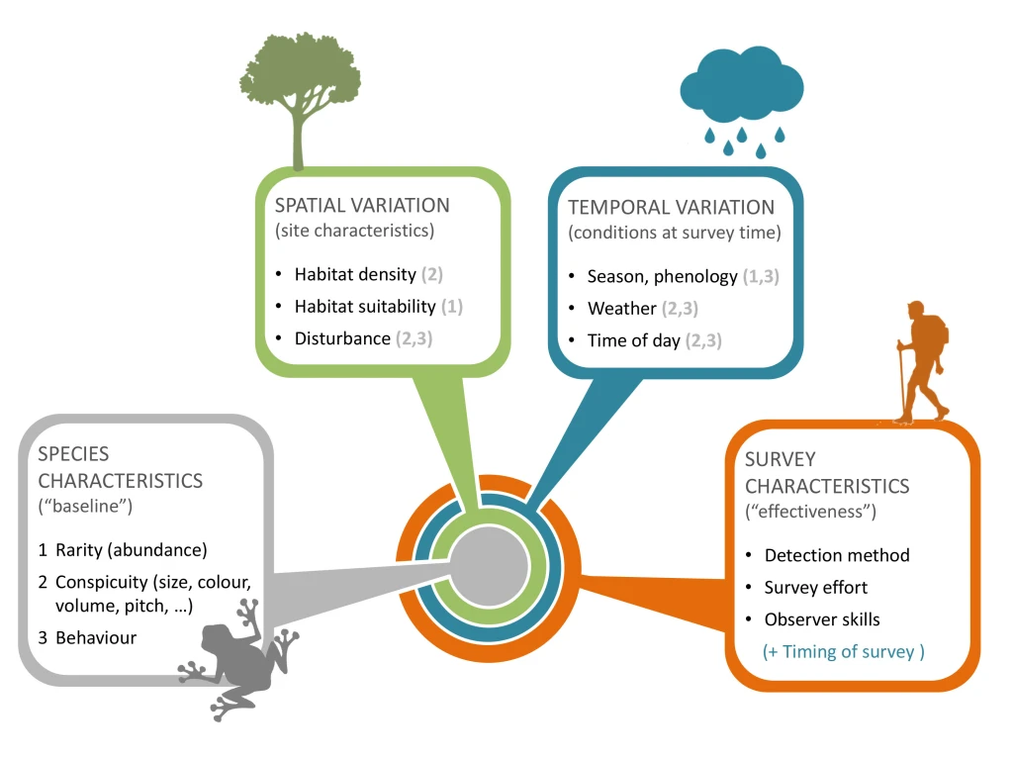
Now you see me, now you don’t

Slide 20
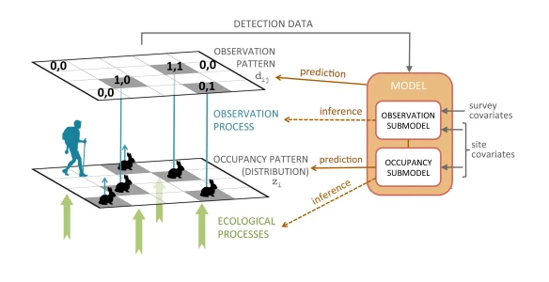

Slide 21
Different types of data
Information in the data
Occurrence locations
Presence and absence data
Detection and non-detection data

Slide 22
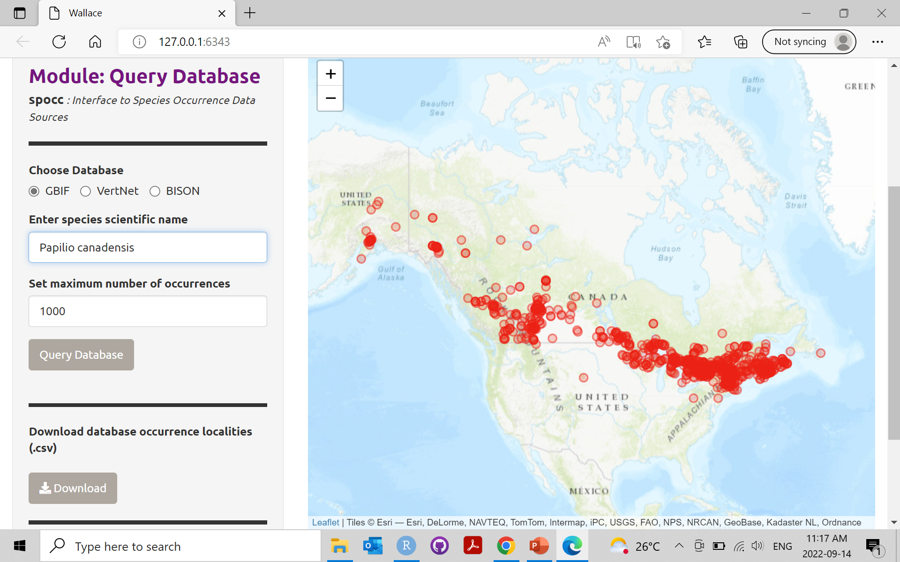

Slide 23
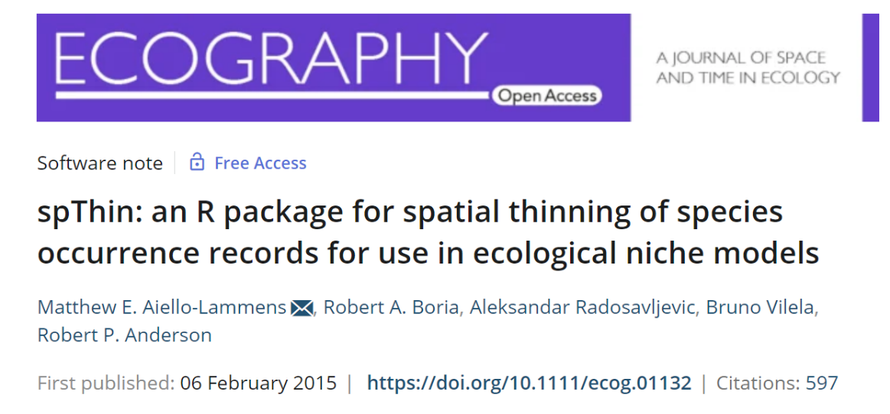
Spatial thinning
Remove observations to reduce bias towards highly-sampled locations
If you want to know more about thinning:

Slide 24
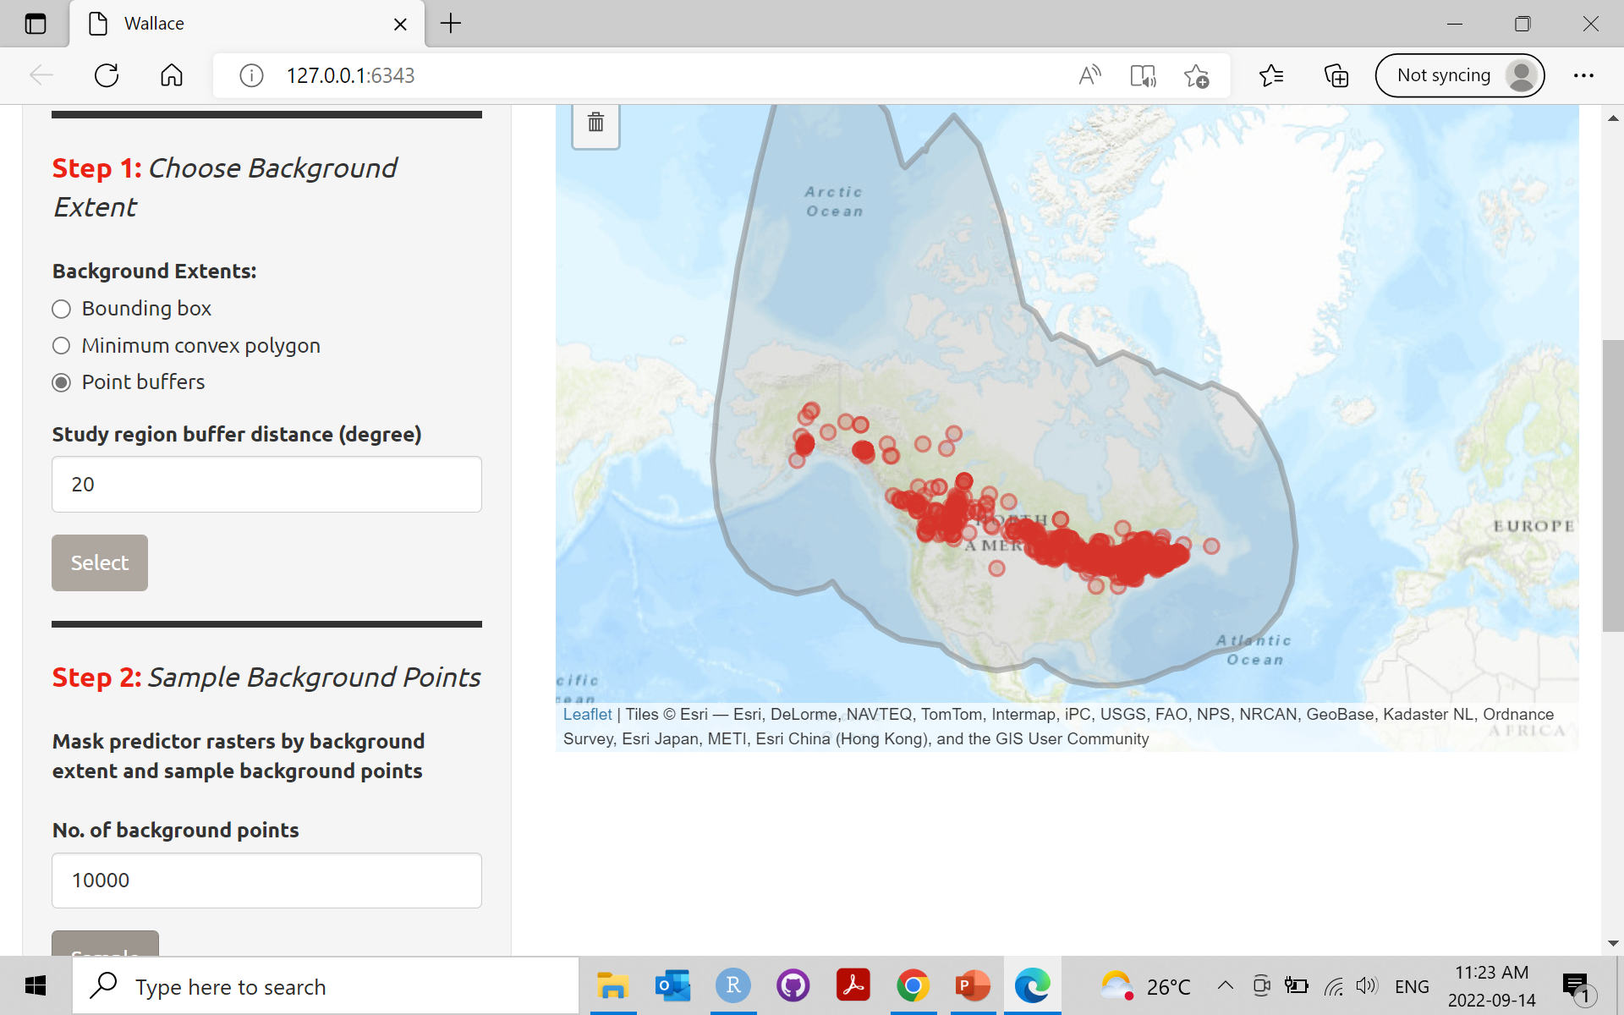

Slide 25
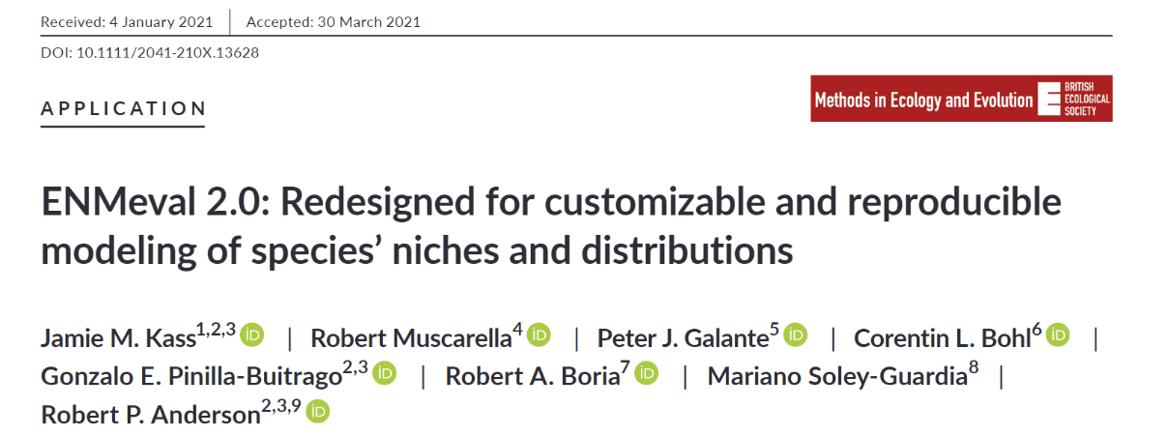
Partitioning occurrences
Divide the occurrence data in subsets and fit the model multiple times to assess how spatial distribution of points affect the model performance
If you want to know more about partitioning:

Slide 26
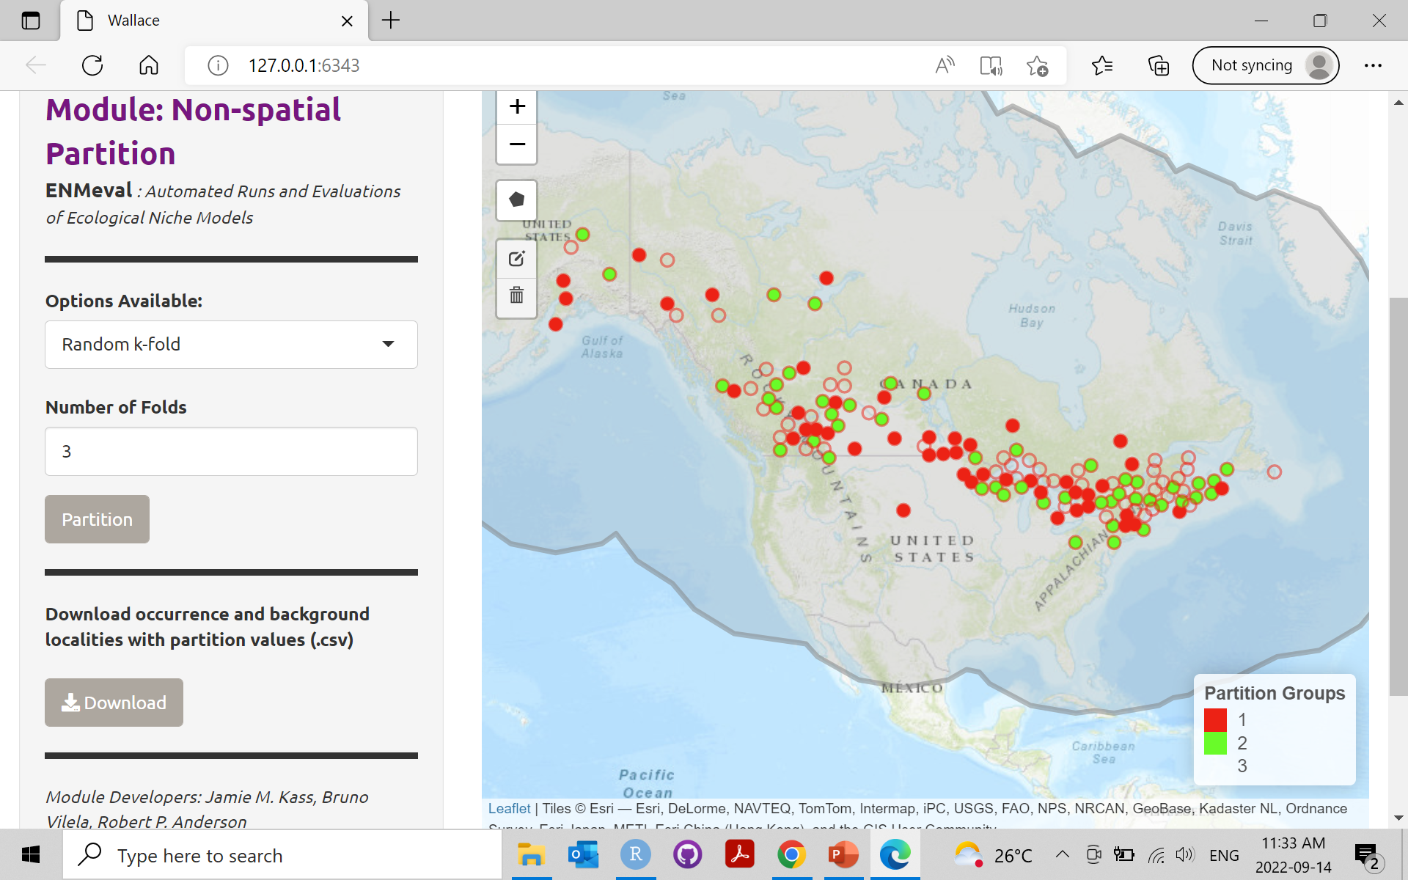

Slide 27
Modeling

Slide 28
Model
The algorithm used to infer species-environment relationships, and thus to generate spatial predictions of species distributions
Wallace allows two choosing between two algorithms:
Bioclim
Maxent

Slide 29
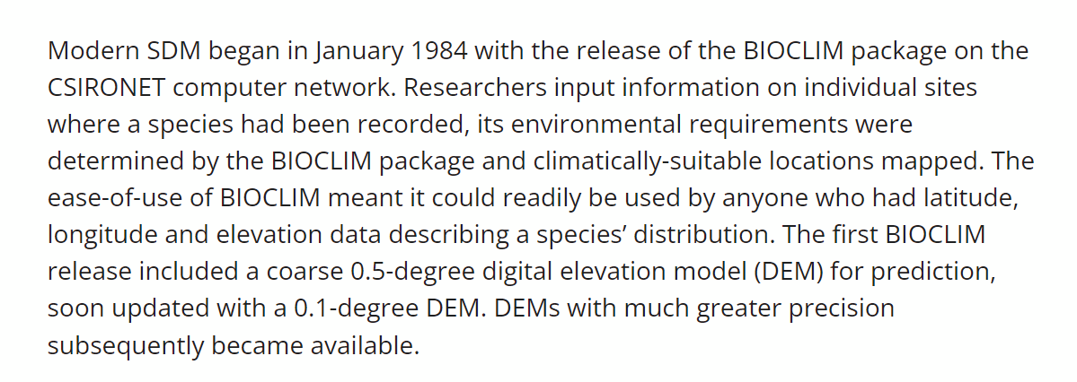
Bioclim
https://csiropedia.csiro.au/bioclim/

Slide 30
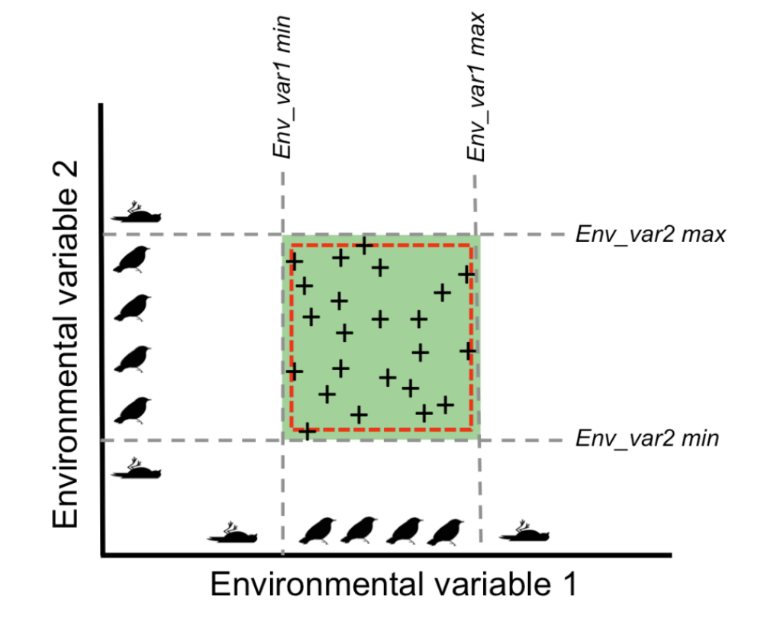
Bioclim
Bioclim is a so-called envelope-style method, which uses only occurrence data to define a multi-dimensional environmental space in which a species can occur. This environmental space is constructed as a bounding box around the minimum and maximum values of the environmental variables for all occurrences, resulting in a multi-dimensional rectilinear envelope.

Slide 31
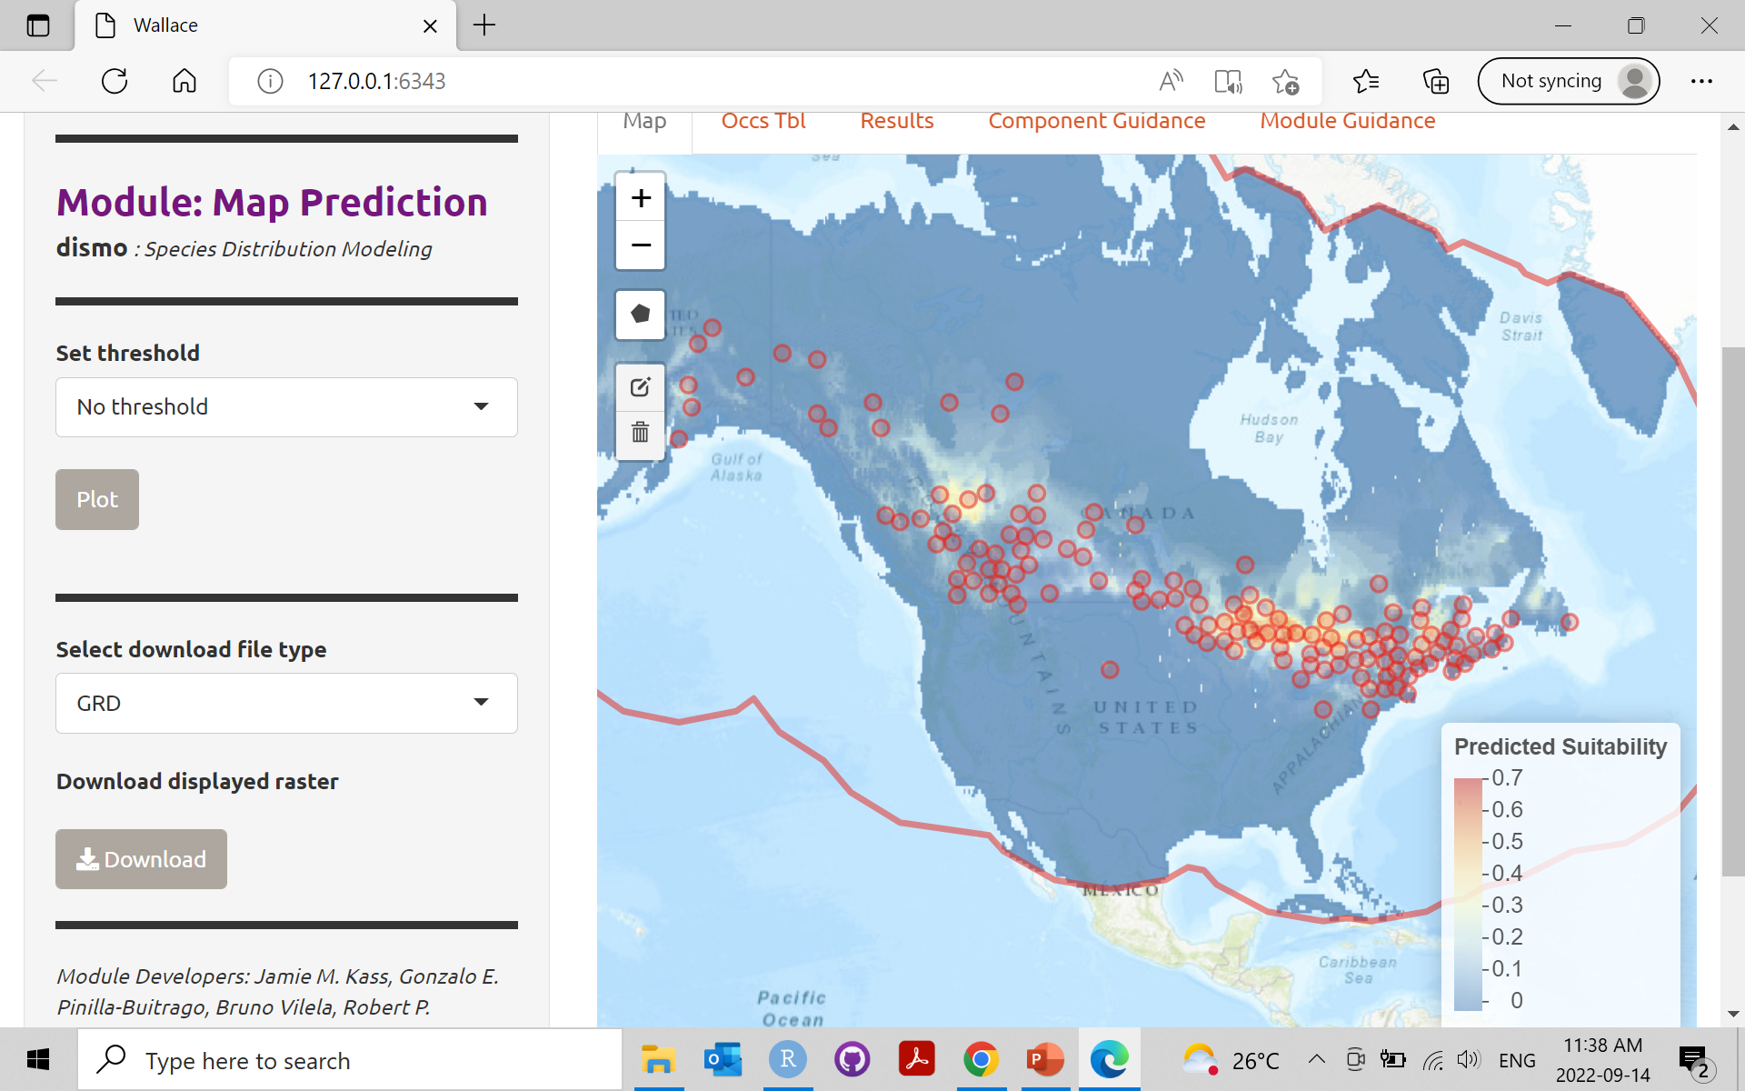
Bioclim

Slide 32
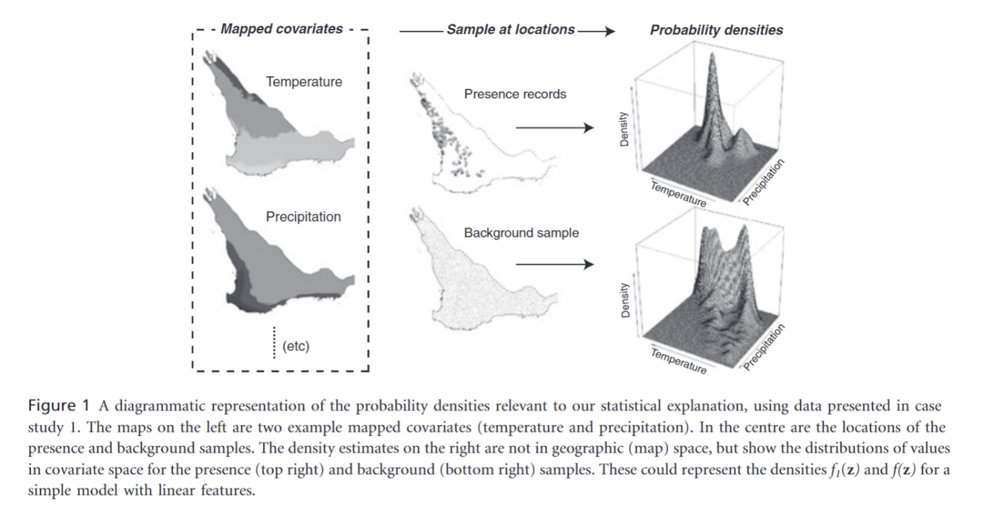
MaxEnt
Follows the maximum entropy principle, i.e., predicts species occurrences by finding the distribution that is most spread out, or closest to uniform, while taking into account the constraints provided by the environmental variables of occurrence locations

Slide 33
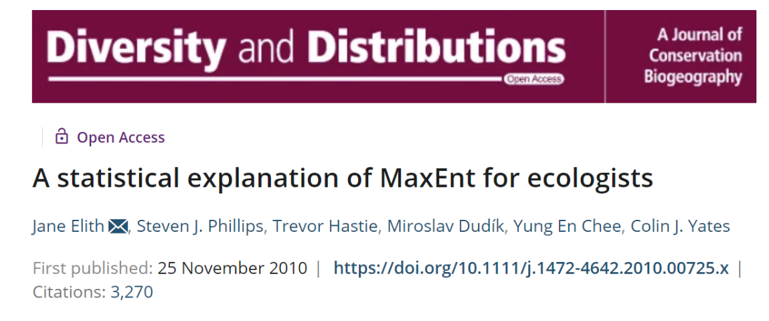
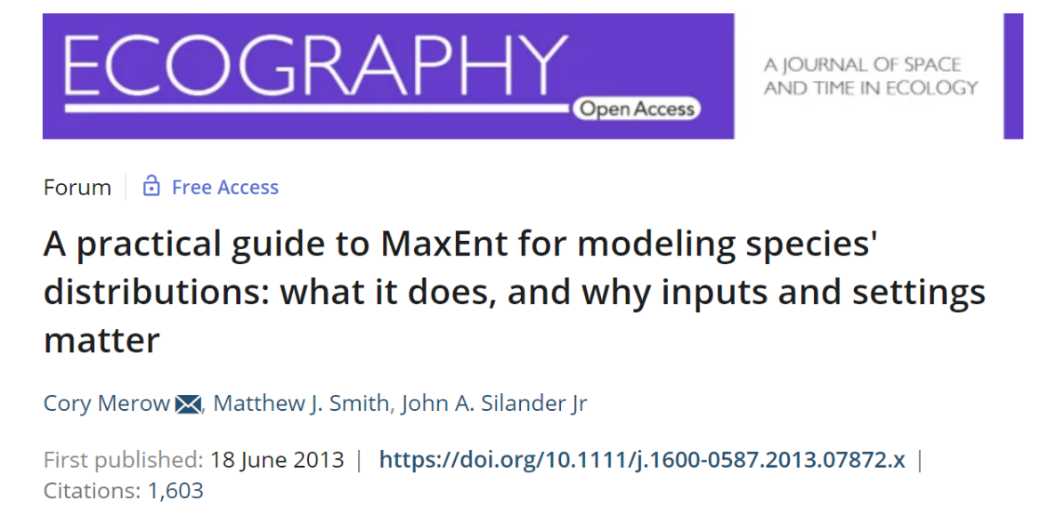

Slide 34
MaxEnt
Features: the bioclimatic predictors in the model
Feature types: the shape of the relationship that MaxEnt is allowed to explore estimating the species-environment relationships
Regularization: automatic procedure that retains only features relevant for predicting the species
Reguralization multipliers: setting that determines penalization in the model for additional parameters

Slide 35
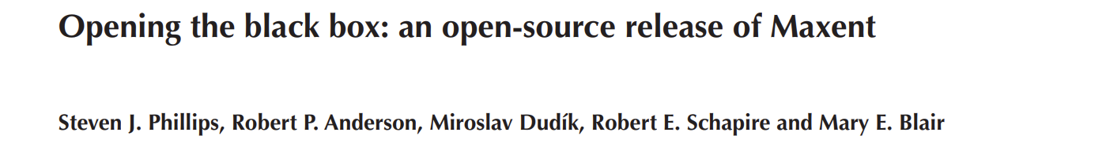
Maxent estimates the distribution (geographic range) of a species by finding the distribution which has maximum entropy (i.e. is closest to geographically uniform) subject to constraints derived from environmental conditions at recorded occurrence locations.
The constraints are defined in terms of ‘features’ (environmental variables such as temperature, and simple functions of those variables such as quadratic terms), and require that the mean of each feature should match the sample mean.
This formulation is equivalent to maximizing the likelihood of a parametric exponential distribution. More recently, it was noted that the exact same maximum likelihood exponential model can be obtained from an inhomogeneous Poisson process (IPP)

Slide 36
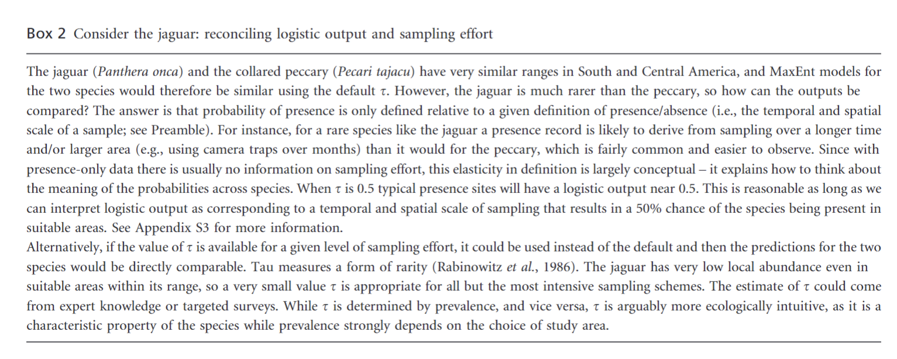
Rarity and prevalence in MaxEnt

Slide 38
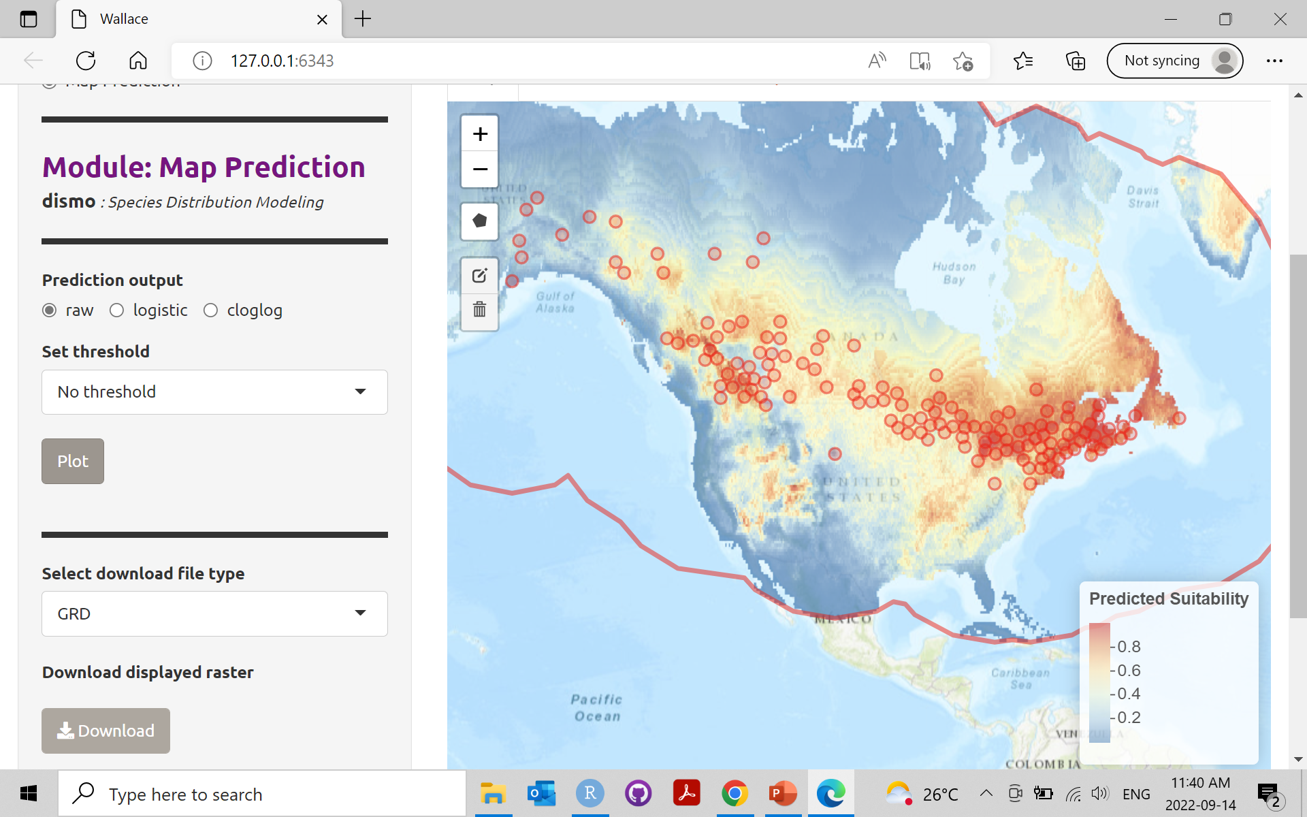
MaxEnt

Slide 39
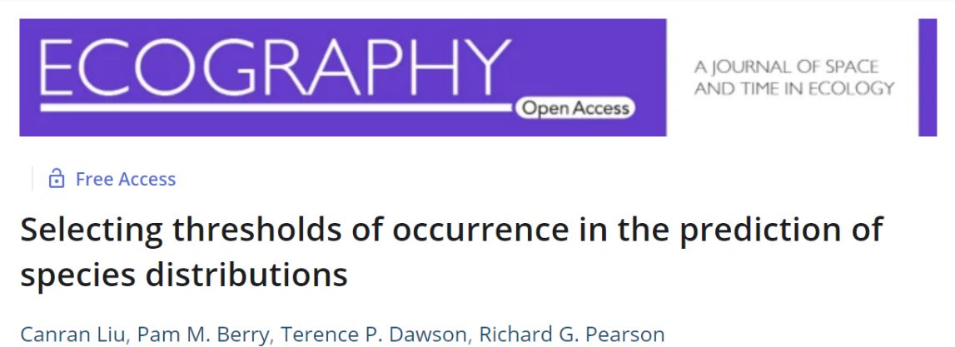
Thresholding
Transforming a continuous model output into a binary map based on a classification criterion (e.g., the value that equalizes sensitivity and specificity)
If you want to know more about thresholding:

Slide 40
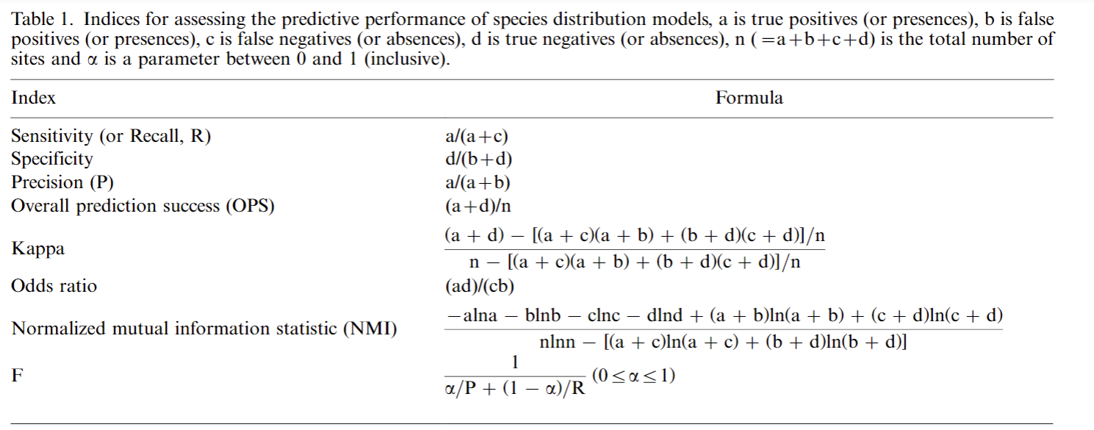

Slide 41
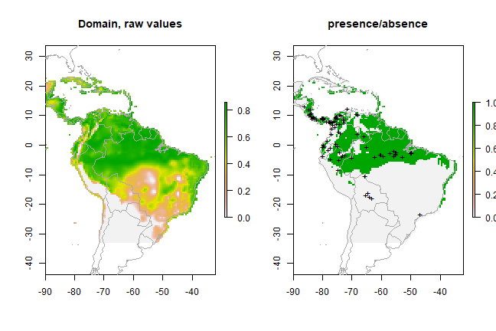
https://babichmorrowc.github.io/post/2019-04-12-sdm-threshold/

Slide 42
Beyond first steps

Slide 43
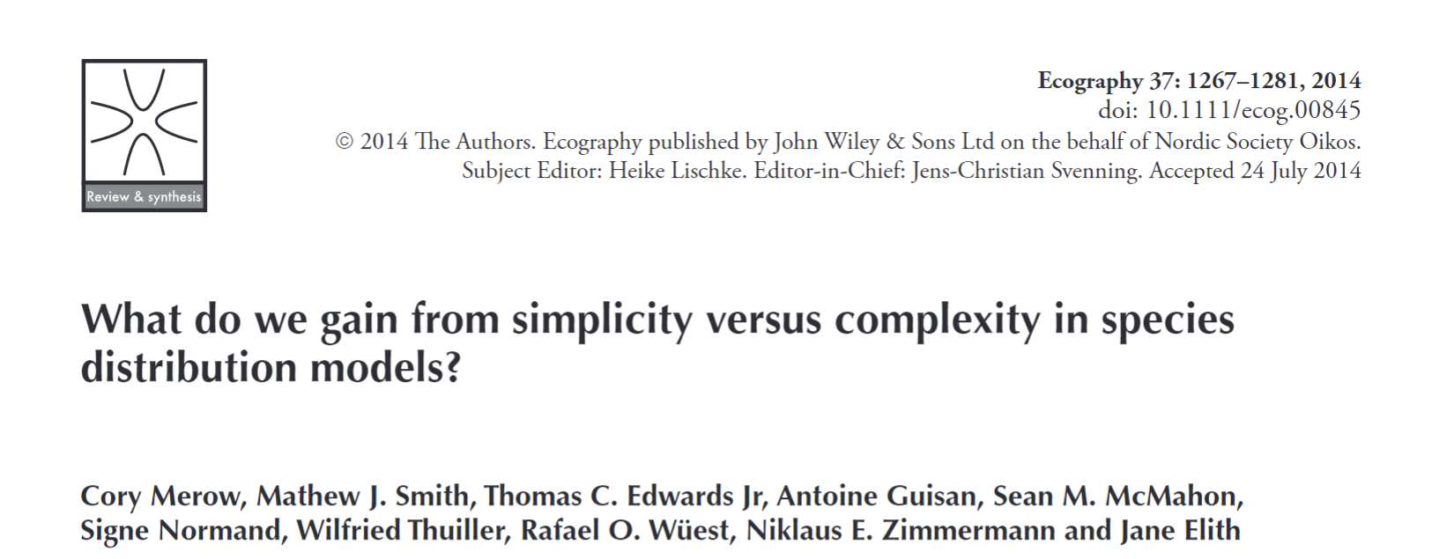

Slide 44
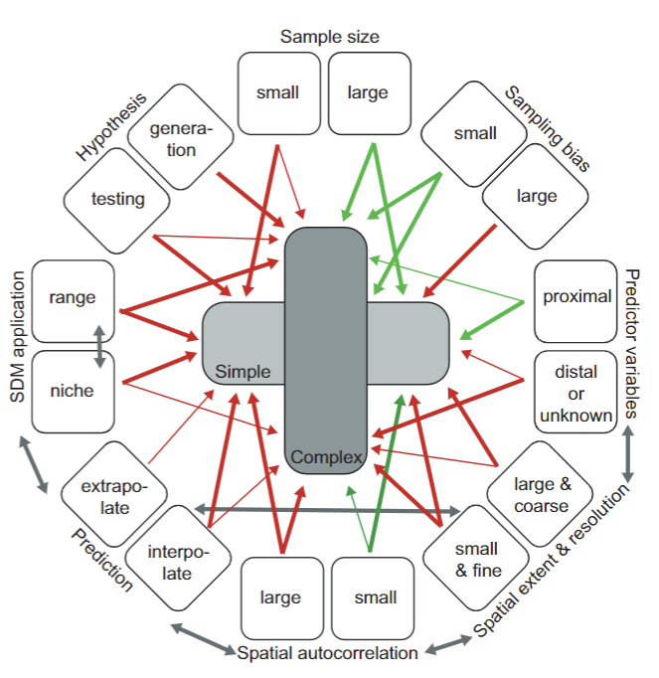
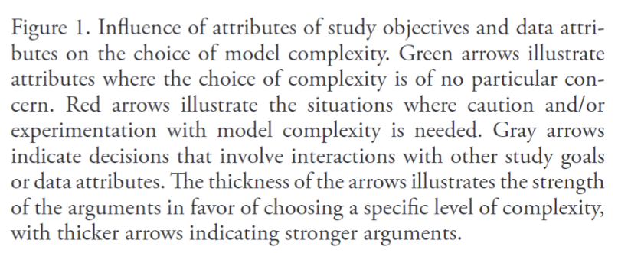

Slide 45
Applications in conservation

Slide 46
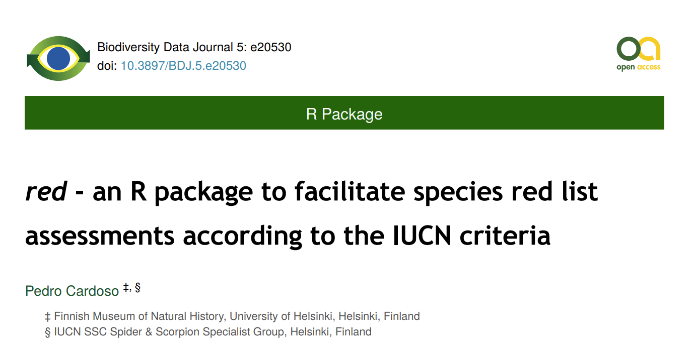

Slide 47
